Slide 1


Database Final Presentation
Andrew, Alex, and Kathleen

Slide 2
Description of Application
Our goal was to create an app that staff at a movie theater can use to keep track of stock, menu items, and ticket sales and pricing.
We also aimed to make this application very user friendly.
It is written in C# and is a Windows Forms Application.
We use SQL Server to handle our database, and to execute necessary queries.

Slide 3
UML Diagram

Slide 4

Required Queries
Focused on retrieving data for the user based on the field that the data is classified in.
For Example: Retrieve all of the data for concessions that the inventory is below a certain range.

Slide 5

Queries
Go fetch the number of all of the items that are not fully stocked in inventory
Fetch the movie time for [Movie Name]
Fetch the number of tickets sold for [Movie Name]
Fetch the time for all movies on a given day
Fetch the current employee working in concessions
Fetch Menu for concessions
Fetch Ticket Prices
Fetch Ticket Categories
Fetch Theater number for [Movie Name]
Fetch employee type
Fetch calendar day
Fetch time of day
Fetch current logged users
Fetch current user id
Fetch the number of tickets remaining for a given time in a given theater
Fetch the movie schedule for a time or date range
Fetch all the products that are out of stock and their supplier and their next order date

Slide 6

Discussion of code snippets using embedded SQL Program.CS
namespace TheatreManagerApp
{
static class Program
{
/// <summary>
/// The main entry point for the application.
/// </summary>
[STAThread]
static void Main()
{
Application.EnableVisualStyles();
Application.SetCompatibleTextRenderingDefault(false);
Application.Run(new AppWindow());
}

Slide 7
More Code Utility.CS
namespace TheatreManagerApp
{
internal class Utility
{
internal static string GetConnectionString()
{
string returnValue = null;
ConnectionStringSettings settings = ConfigurationManager.ConnectionStrings["TheatreManagerApp.Properties.Settings.connString"];
if (settings != null)
returnValue = settings.ConnectionString;
return returnValue;
}
internal static OleDbConnection GetOleDBConnection()
{
string ConnectionPath = "Provider=sqloledb; Data Source = CS1; Initial Catalog = TheaterDB; Integrated Security = SSPI;";
OleDbConnection MyConnection = new OleDbConnection(ConnectionPath);
return MyConnection;
}
}
}

Slide 8
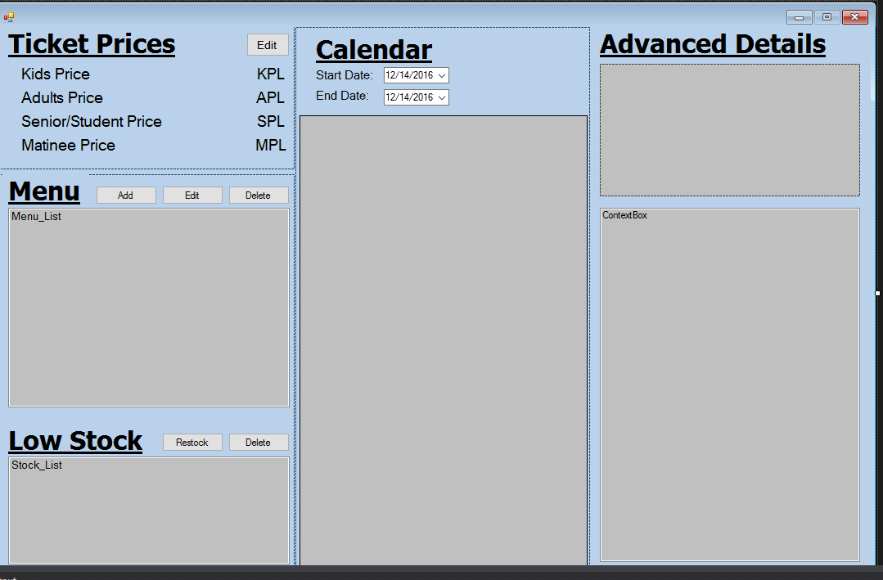
Project Application Demo
Our project is made in C#
It is a Windows Forms application.
Our program uses a 3 panel approach to display data to the user.
We can access each panel through separate functions that load data from the database.

Slide 9

Class Concepts
Applied
Not Applied
Connecting a database to an application
SQL Server database storage
Relational model for a database system
No SQL concepts
Memory management techniques
Normalization (to a degree)

Slide 10


Post-mortem
What went right?
As far as what went right, we did get the database to work with out application, as well as, we did create a working application that executes the processes needed to run a movie theater.
We collaborated and worked to make a functioning project that met most of our goals.
What could have been done better?
We could have potentially made a more detailed application.
We did have a little bit of trouble with Github and merging data to be committed, but that is more of a side issue.
We also did simplify our original idea quite a bit. We definitely could have optimized and tested our code much more thoroughly throughout the entire development process.

